Slide 1
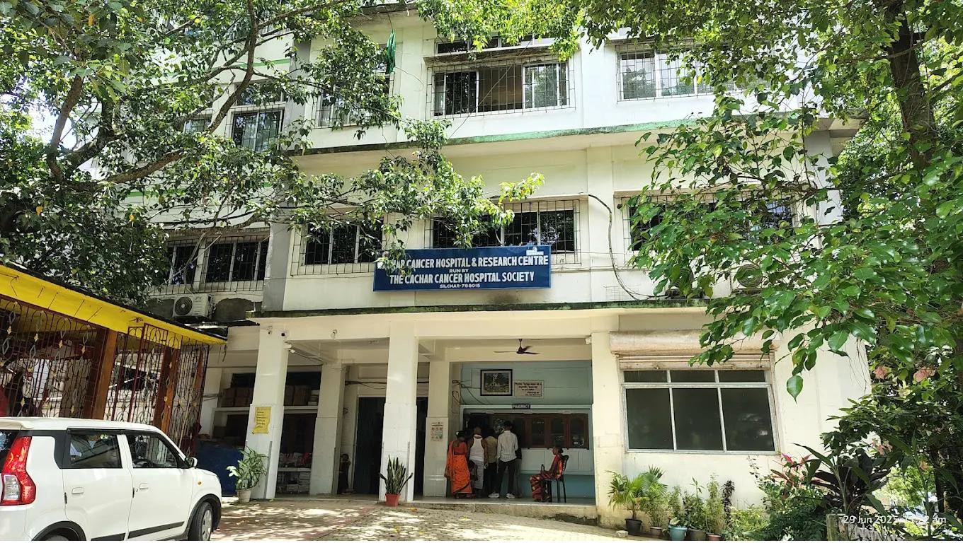
Demo of Digital Designing & 3D Printing At Cachar Cancer Hospital & Research Center
“4IR Application In Improving Quality of Cancer Surgery”

Slide 2
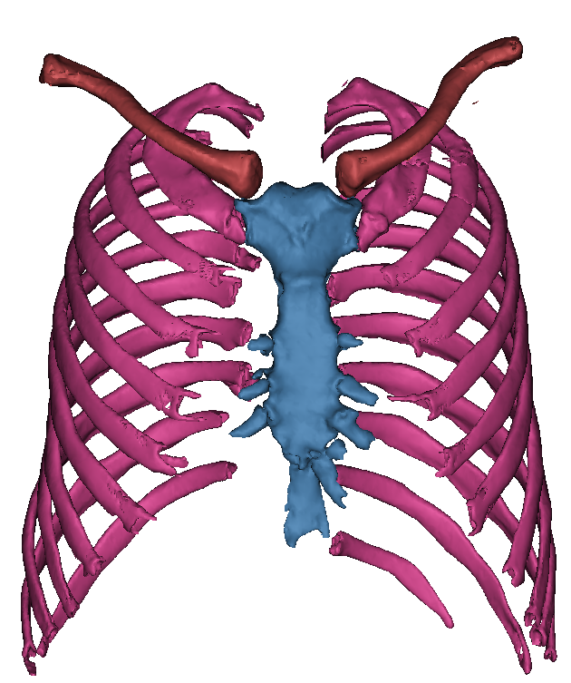
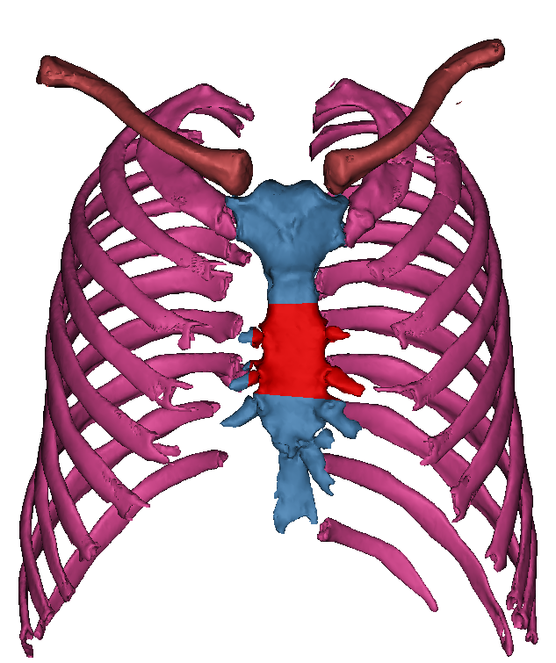
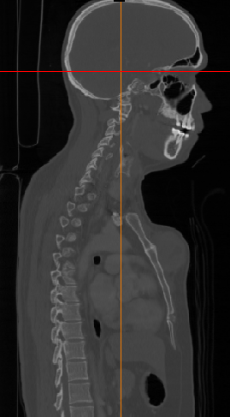
Segmentation Based on CT data for Sternum And Rib Portion
CT Scan Data
CT Scan Convert 3d Model
Modelling of Infected Area

Slide 3
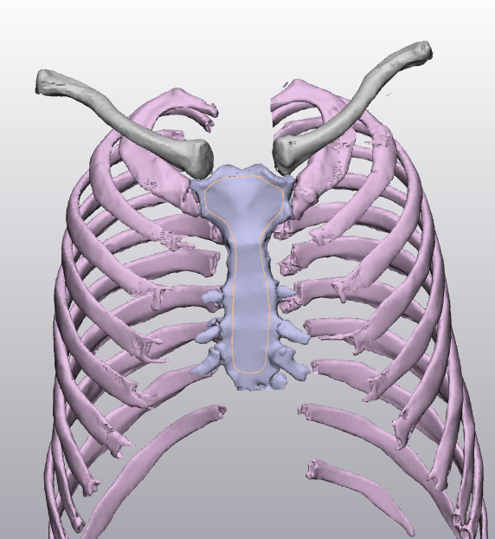
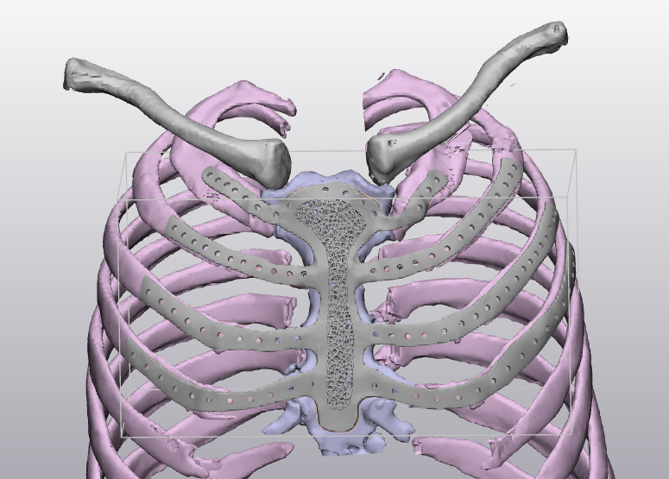
The Implant is Prepared Using the Sternum and Rib
Sternum top surface Use To design the Implant
Complete Designing sternum implant

Slide 4
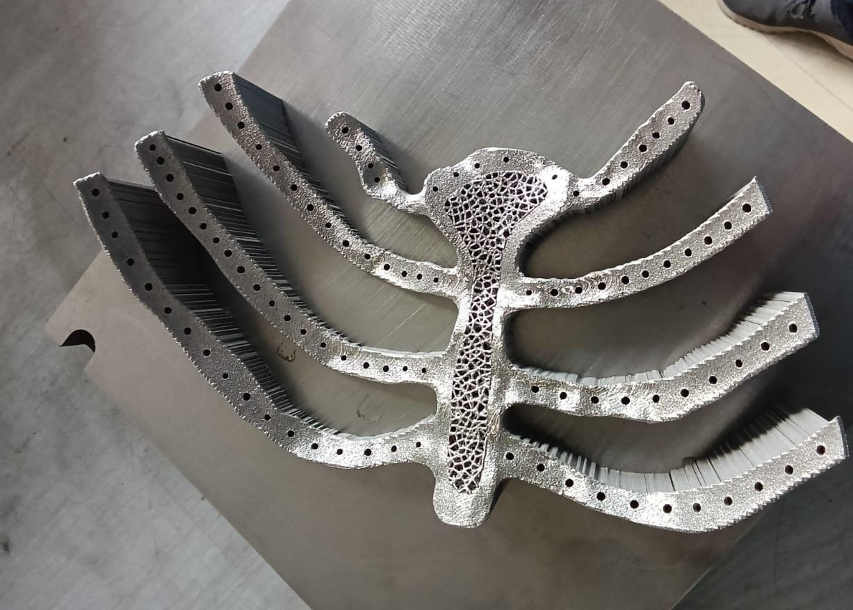
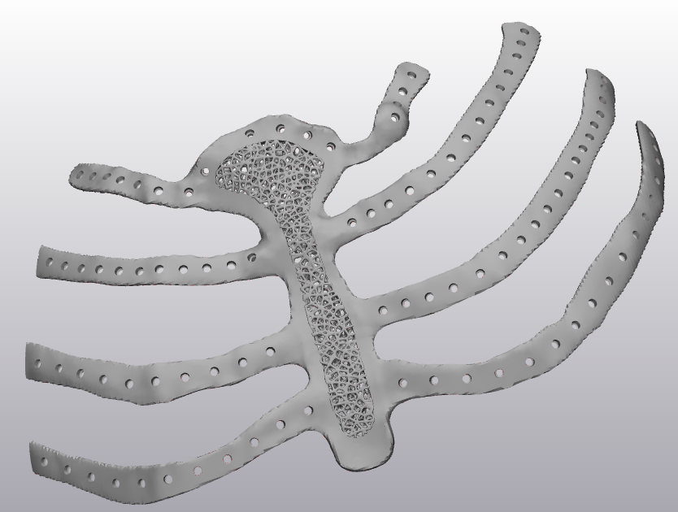
3D metal Printing After the Sternum Implant design
Sternum 3d Implant
After the 3d metal Printing Implant

Slide 5
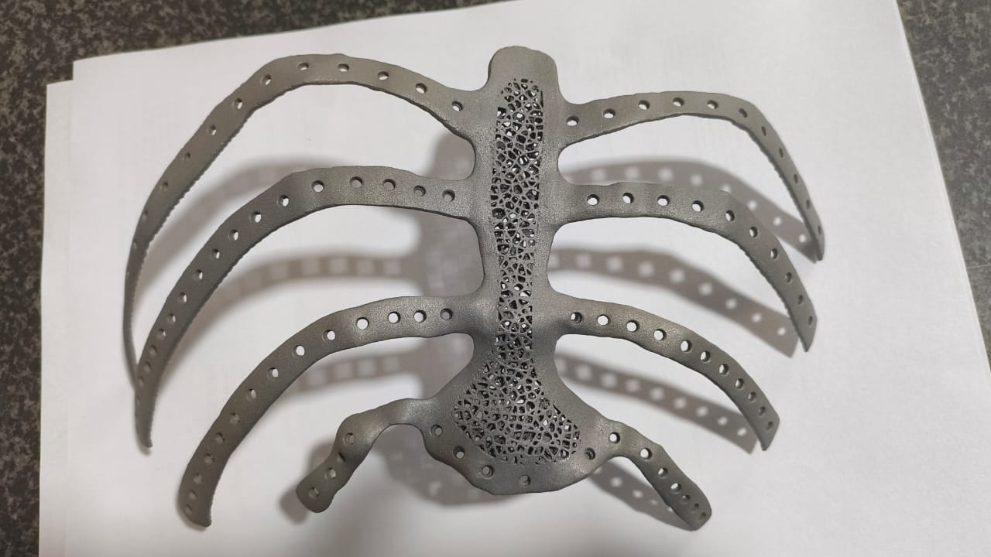
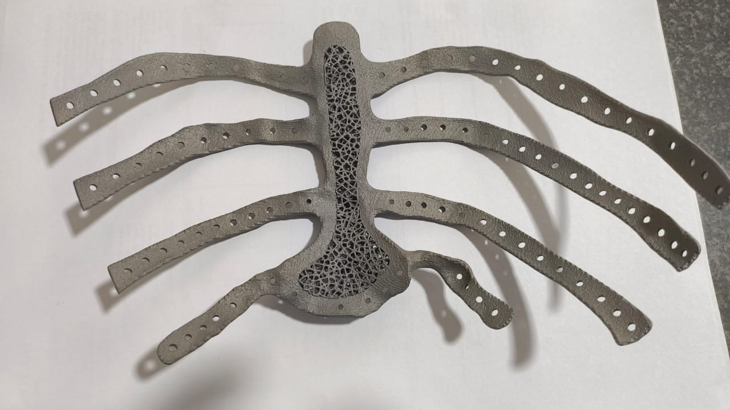
After Post Processing the Final 3D metal Printing Sternum Implant
Sternum 3d printed Implant

Slide 6
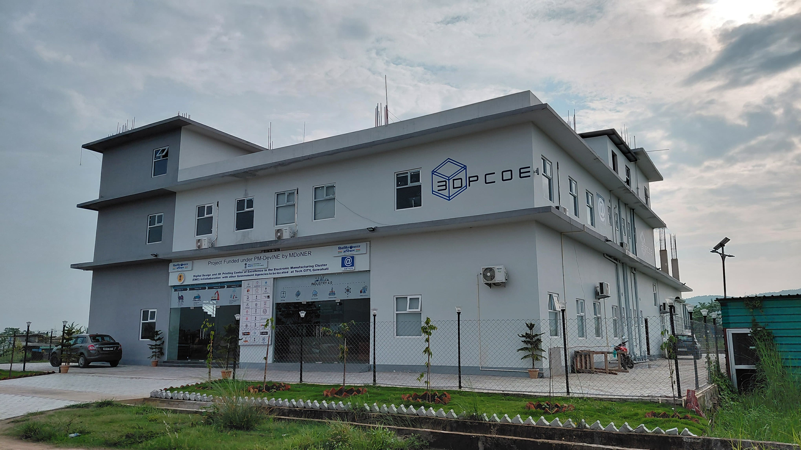
THANK YOU 🙏

